Slide 1
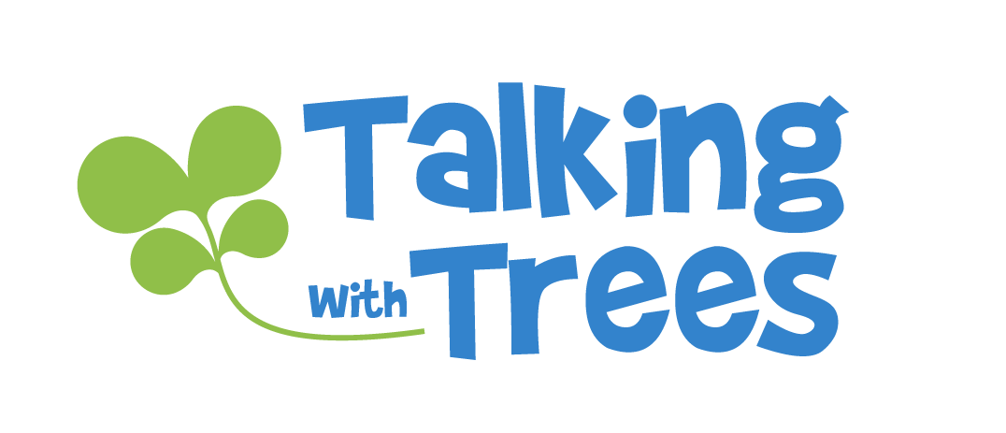
What is…
Responsibility?
TalkingTreeBooks.com
© 2021, 2023
LoveWell Press
Notes:
1

Slide 2
Ways we talk about Responsibility
Take responsibility for your actions
Act responsibly
Be responsible
It’s your responsibility
Notes:
Ways we Talk about Responsibility
There are different ways we use the word responsibility, including Be responsible, Take responsibility, It’s your responsibility, Act responsibly.
What are some other ways students hear the word “Responsible” used?
All of these ways of talking about responsibility are related to doing the things we are supposed to do,or doing the things we are responsible for.

Slide 3
What is Responsibility?
A responsibility is something you are expected to do
When you DO something you are responsible for
There is a result
Being responsible means
you do the things you are supposed to do
you accept the results of your actions
When you DON’T do something you are responsible for
There is a consequence
Notes:
What is Responsibility
Explain what a responsibility is- it’s something you are expected to do.
When you do the thing you are expected to do, you are being responsible, and a positive result occurs.
When you do not do the thing you are supposed to do, you are not being responsible, or being irresponsible, and there is a negative consequence for having neglected your responsibility.
Being responsible has two components- 1) the act of doing the thing you are responsible for, and 2) accepting the good or negative outcome of your actions.

Slide 4
Examples of Responsibilities
Tasks you are expected to do:
Ways you are expected to act:
Feed the dog
Do your homework
Look after your brother
Put your bicycle away
…
Use the internet safely
Be home on time
Don’t hurt yourself or others
Speak respectfully
…
Notes:
What are some examples of Responsibilities?
Responsibilities can be tasks, or jobs, that you are supposed to do. It’s a responsibility because there is a result or outcome you are working toward. If you don’t do the task, there is a negative result.
Responsibilities can have to do with how we act / behave around others. We are expected to act a certain way (be responsible in how we act) because if we don’t there may be a negative outcome.
Discuss some tasks and behavior expectations and the positive or negative consequences of being responsible or irresponsible. For example:
Do your homework-
If you do it, you learn and it helps prepare you for life. It may also keep your parents and teachers happy and you may get praise.
If you don’t do it, it hurts your ability to learn and grow. Parents and teachers may be disappointed. There may be consequences like losing privileges until your work is done.
Don’t hurt yourself of others
It’s your responsibility think about how you are working in the classroom or playing outside. Acting responsibly helps keep you and others safe from harm.

Slide 5
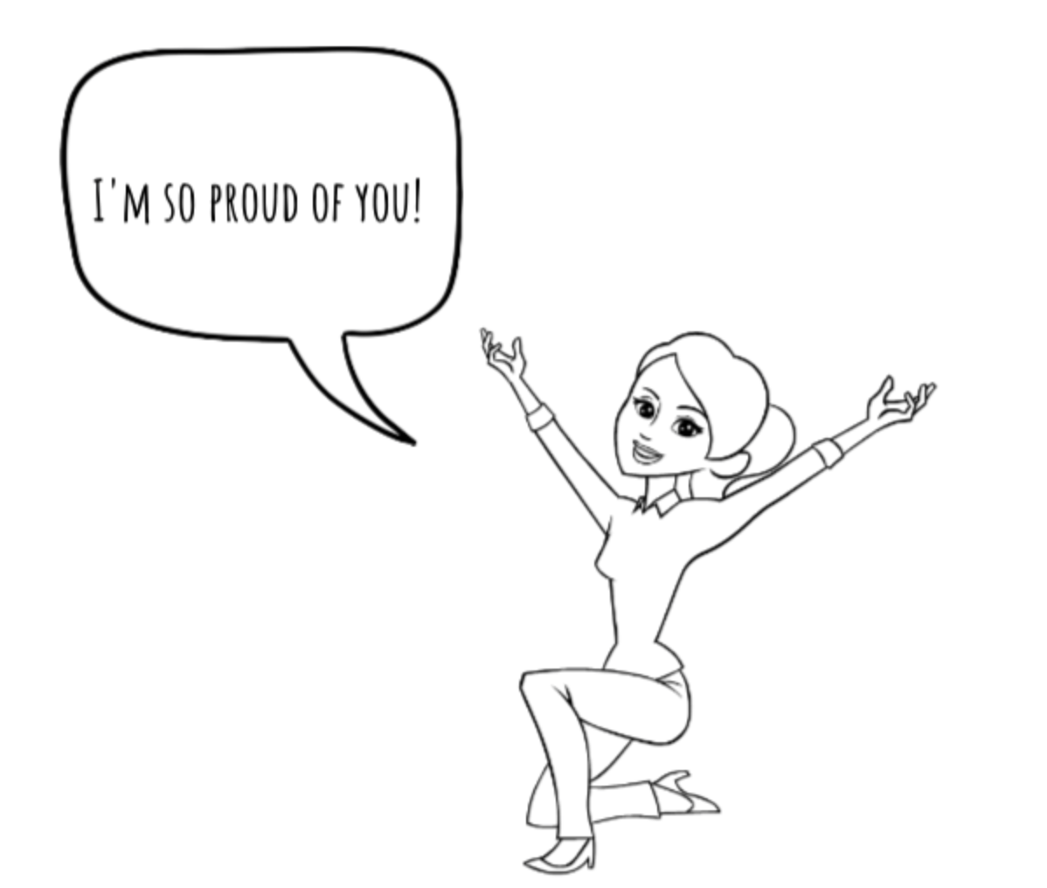
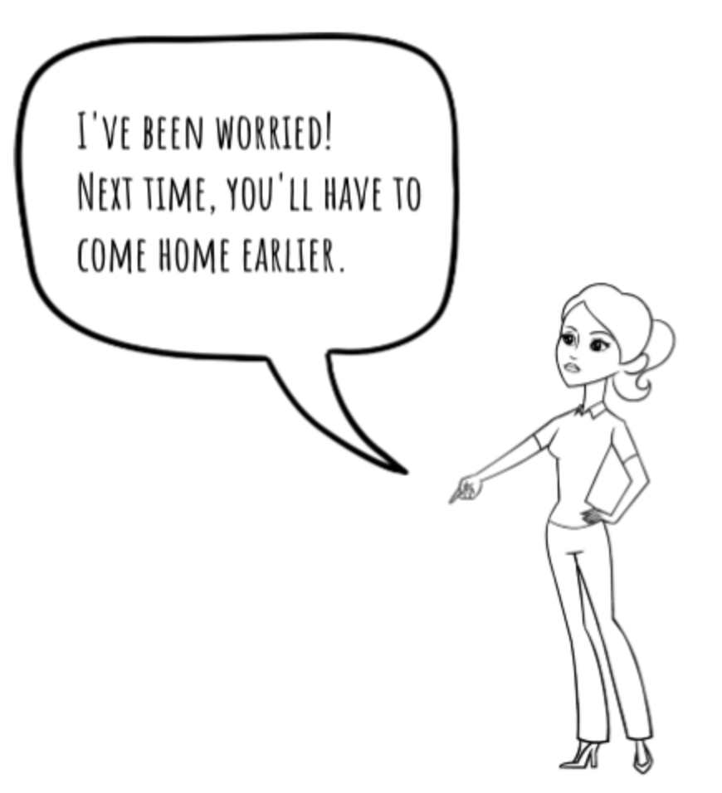
Is this responsible?
Responsibility:
You are expected to be home by 5:00
You are home by 5:00
It’s 5:30 and mom isn’t sure where you are.
Notes:
Responsibility Scenarios
Walk through the examples of being responsible. Compare what a responsible action is and its positive outcome (on the left) with the irresponsible action and its negative consequence (on the right.)
Being responsible is about choosing the right action, but it’s also about taking responsibility for the results (good or bad). How does it feel when you choose the responsible action? How does it feel when you face the consequences of the irresponsible action?
When it’s hard to do the responsible thing, how can thinking about the possible negative outcome (and how bad it will feel later) help you to choose the right action?

Slide 6
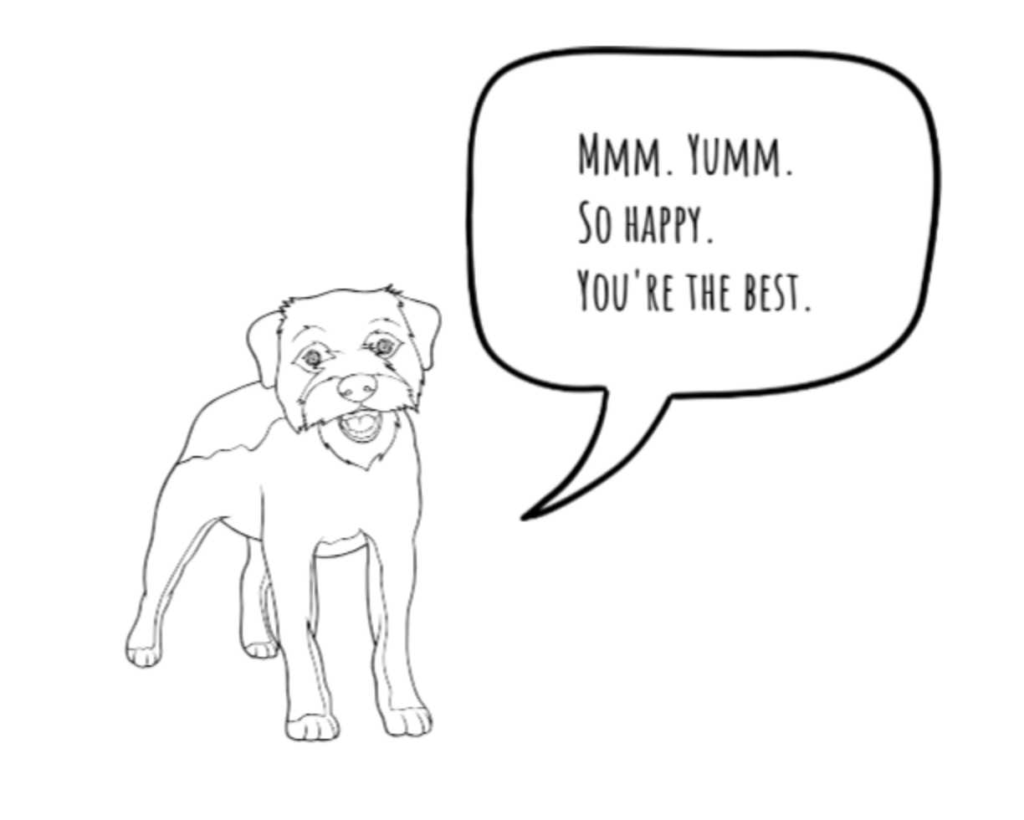
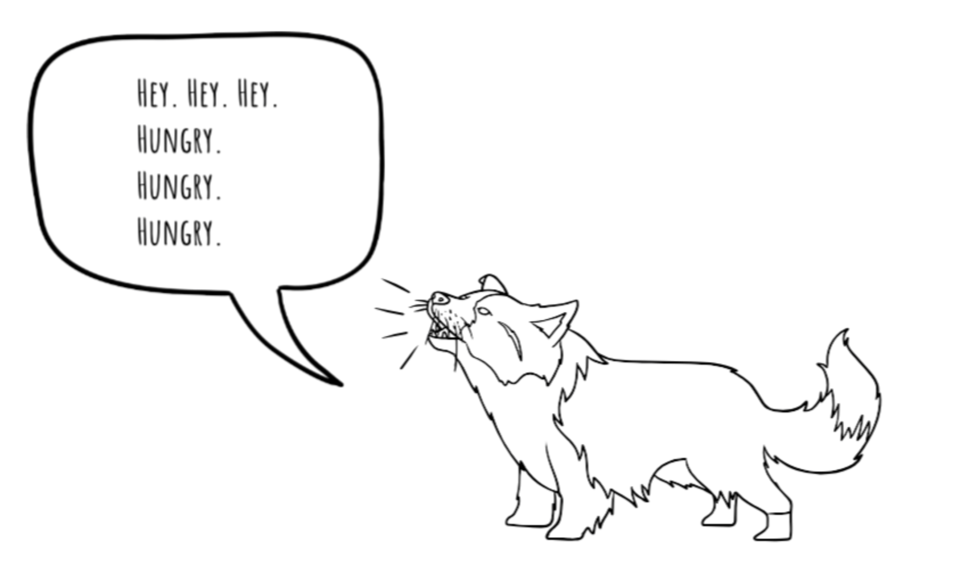
Is this responsible?
Responsibility:
You are supposed to feed the dog
You remember to feed the dog
You forgot to feed the dog.

Slide 7
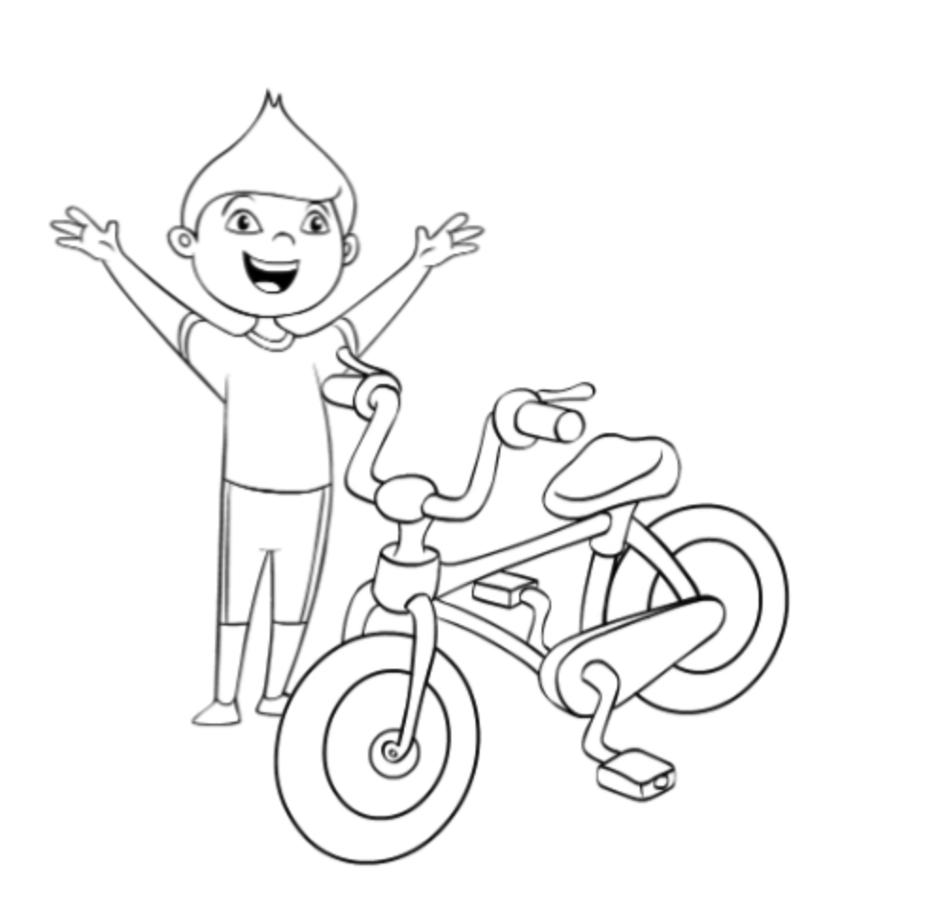
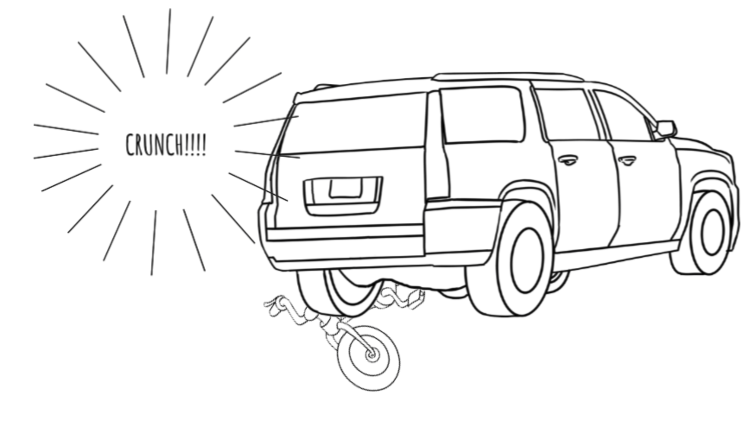
Is this responsible?
Responsibility:
Put your bicycle away.
You put it in the garage where it belongs.
You leave it lying in the driveway behind the car.

Slide 8
How are you responsible?
Responsibility:

Slide 9
Why is Responsibility Important?
Responsibility is important because actions have consequences.
Act Responsibly
The result you want
Don’t act responsibly
Negative consequence
What happens if people are NOT responsible about…
How they play or work with others?
How they take care of their bodies?
How they do their homework?
How they take care of their things and spaces?
Notes:
Why is responsibility important- Actions
Being responsible is about linking actions with their consequences. One way to understand why responsibility is important is to consider what would happen if people were not responsible. For example:
Playing or working with others- What could happen if someone plays too rough with others, doesn’t do their share of a group project, leaves sharp objects on the playground…
Taking care of their body- What could happen if someone eats lots of junk food or they ride their bike down a big hill where they can’t see cars coming?
Taking care of things and spaces: What could happen if people don’t pick up their trash, or don’t take care of their houses, or leave their toys lying around in the rain?
Sometimes if one person doesn’t do something it isn’t a big deal. But what if everybody did it?
Being responsible is a group effort- we each need to be responsible to others the way we’d like them to be responsible for our sake.

Slide 10
Why is Responsibility Important?
Because being responsible feels better in the long run
How do each of these situations feel?
vs.
vs.
Sometimes not doing the things we need to do feels good for a little while, but later, it feels bad.
vs.
Notes:
Why is responsibility important- Feelings
Being responsible feels better than being irresponsible, in the long run. Sometimes it’s hard to do the right, or responsible, thing in the moment. It can be tempting to do what you want to do instead of what you need to do. But long term, actions have consequences. Being responsible gets you the result you want. Irresponsible decisions lead to negative consequences that are no fun.
When it’s hard to do the responsible thing, think about how it will feel later when you have to pay for the consequences of your actions.
When you’re a kid, it may not seem like that big of a deal. As you get older, the choices and the consequences become more significant

Slide 11
What is Responsibility?
Being responsible means
you do the things you are supposed to do
you accept the results of your actions
Notes:
Summary- What is Responsibility
Restate what responsibility is.

