Slide 1
What is…
Honesty?
TalkingTreeBooks.com
© 2021, 2023
LoveWell Press
© 2021 LoveWell Press
Notes:
What is Honesty Presentation
Find lessons plan and worksheets that work well with this presentation at TalkingTreeBooks.com> Activities/Teaching
1

Slide 2
What is honesty?
Being honest means you do and say things that are truthful
Truthful:
Saying or showing what happened in the real world, based on facts, not imagination
Notes:
What is honesty?
Honesty is about telling the real, whole truth. That means saying what really happened, based on facts and reality.
Stories that come from our imagination aren’t real and aren’t based on fact. Sometimes young children have trouble separating what’s true and what’s imagination. We can “tell a story” from our imagination, but we should be clear it’s a story. If we tell the story as if it really happened, then that’s being dishonest.

Slide 3
Ways to be honest
Telling the Truth
Saying what really happened, based on facts
Lying is dishonest
Not Hiding The Truth
Showing or telling the whole truth
Hiding the truth is called deceit or trickery and it’s dishonest
Acting Truthfully
Not doing things that involve tricking or hurting others for your own benefit
Acts like cheating, stealing, and misleading are dishonest
Notes:
Ways to be Honest
What are some examples of each type of honesty/ dishonesty
Honesty includes speaking the truth, the whole truth, and only the truth.
Types of Lying: leaving out important parts of the truth on purpose, bending the truth, elaborating on the truth, telling a made-up story but saying it really happened, saying things happened differently than what really happened
Not hiding the truth
Usually when people hide the truth, it’s because they know they did something they might get in trouble for. Hiding the truth to trick other people is dishonest. Deceit includes hiding, distorting, or changing what really happened (facts).
Acting Truthfully
When we do things that trick or hurt others for our own gain, this is considered morally wrong and dishonest. Cheating, stealing, misleading people, saying you’ll do one thing and then doing something else… these are all forms of dishonesty.

Slide 4
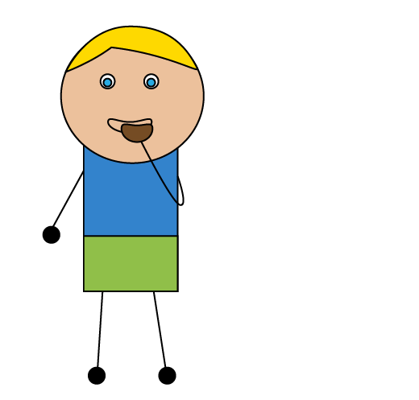
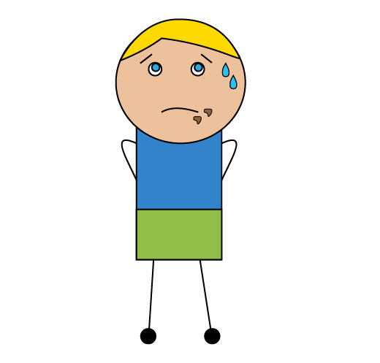
Is this honest?
1
2
Who ate the cookies?
I don’t know.
Being honest means you tell the truth. Saying something that is not true is lying.

Slide 5
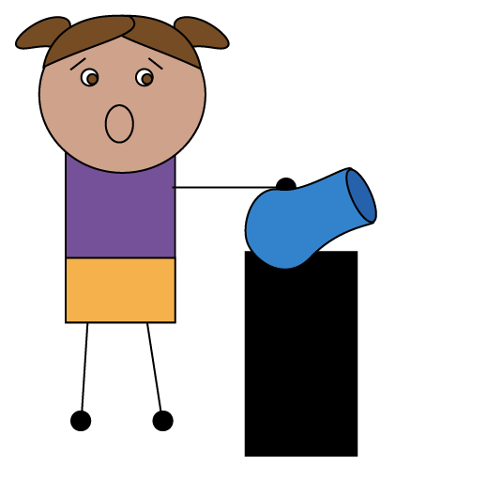
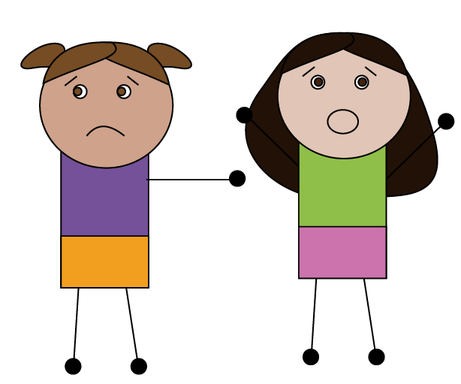
Is this honest?
1
2
Being honest means you say what really happened. Saying things happened differently is dishonest.

Slide 6
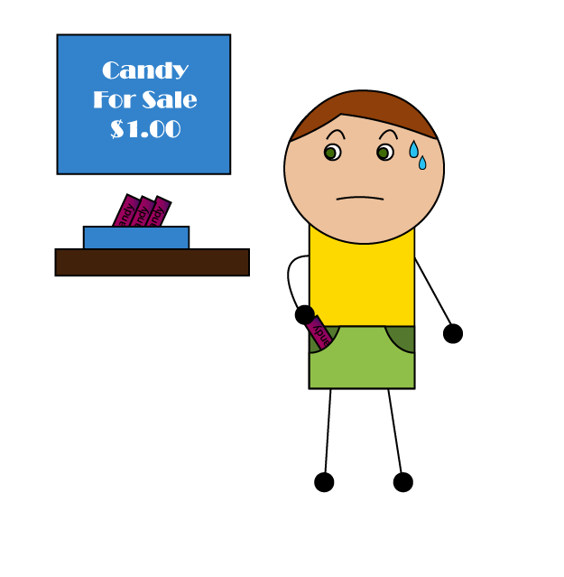
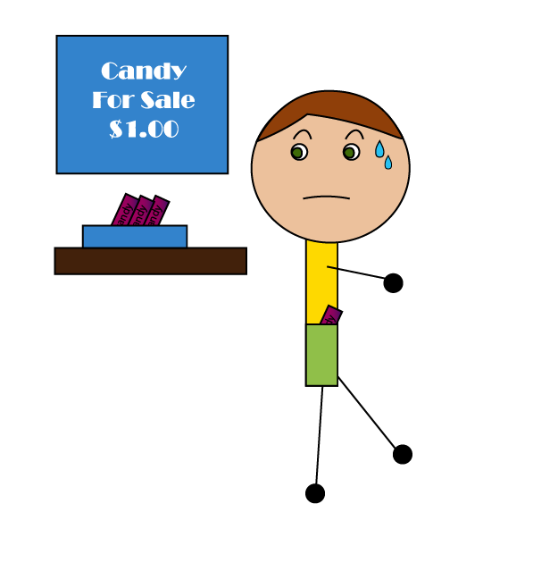
Is this honest?
1
2
Acting with honesty means you don’t trick or harm others for your benefit. Stealing is dishonest.

Slide 7
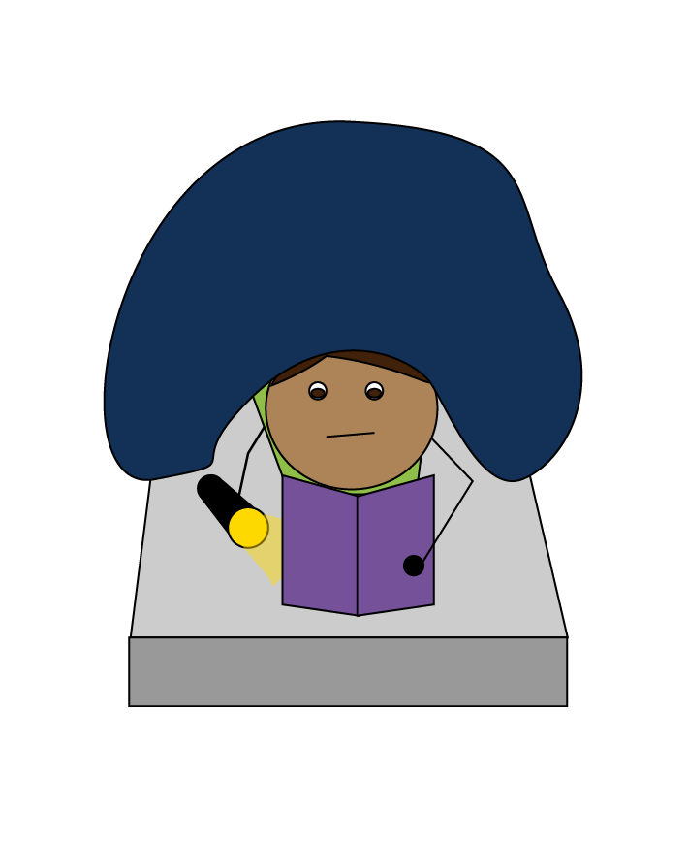
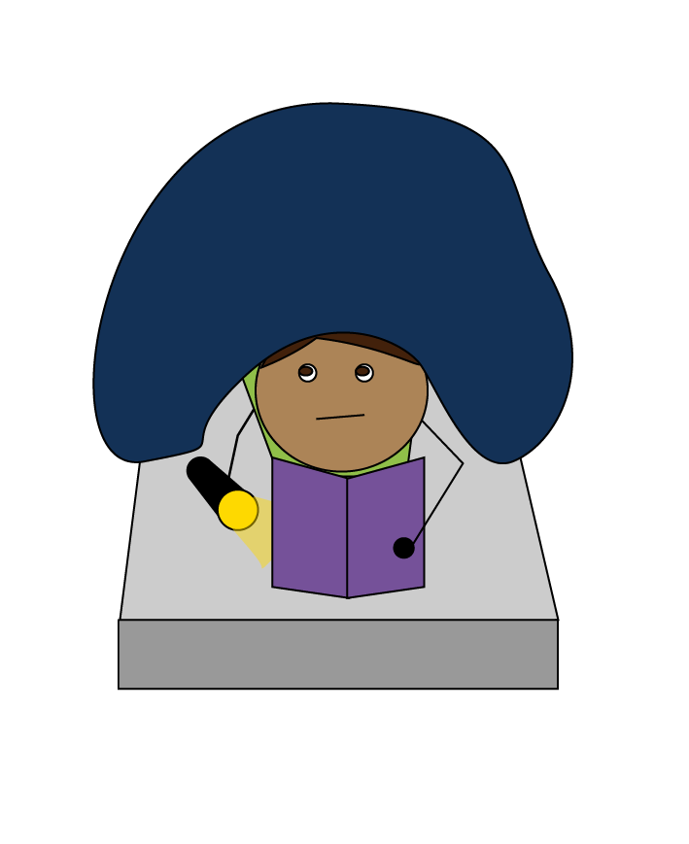
Is this honest?
1
2
You are sleeping in there, right?
Being honest means you are truthful in your actions.
Hiding actions you know are wrong is dishonest.
Notes:
A quick note- sometimes children think that if they don’t speak a lie, they aren’t being dishonest. But hiding the truth, even if no one else knows about it, is still dishonest.

Slide 8
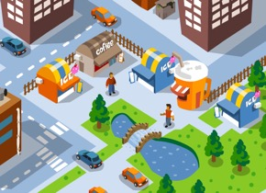
Why is honesty important?
We all need honesty to live together in a society.
Society
Trust
Safety
Notes:
To live together in a society, we all agree on certain principles to be able to trust each other and live together safely. Honesty is important for people in society to get along and live among each other.

Slide 9
What would happen if everyone lied and tricked each other?
To live and work together, we need to know we can trust each other.
Society
Honesty
Trust
Safety
Notes:
One easy way to see why honesty is important is to picture a world where people aren’t honest and can lie and trick as much as they want. What would happen?
What if your classmate blamed someone else so they wouldn’t get in trouble?
What if your friends could steal your toys whenever they came over to play?
What if your classmate took your homework and said it was theirs. Then when you tried to show the teacher the truth, the classmate lied about it?
What if you ordered a new book online and the company said they would ship it to you; but when the box arrived, it was just a box of rocks?
What if your brother saw your backpack and hid it. Then when you were searching for it, he just said, “Yeah, I saw it earlier.”
Our society is built on the trust and safety that comes from all of us agreeing to be honest in how we deal with each other.

Slide 10
What is honesty?
Being honest means you do and say things that are truthful
Notes:
Find worksheets, coloring pages, and more activities that work well with the lesson at https://TalkingTreeBooks.com > Activities

