Slide 1
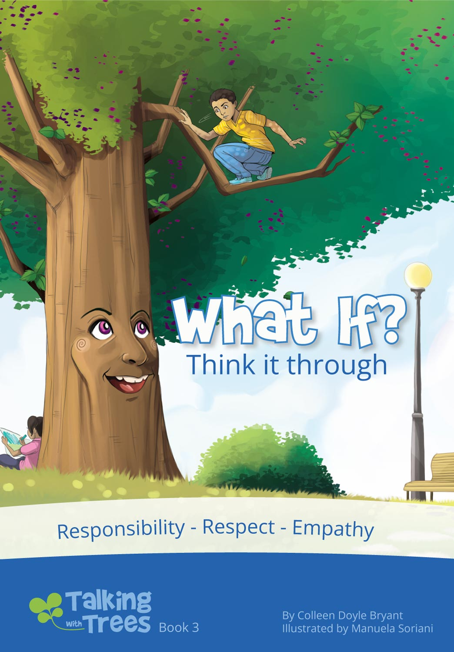
What is…
Empathy?
with the characters from What if
TalkingTreeBooks.com
© 2021, 2023 LoveWell Press

Slide 2
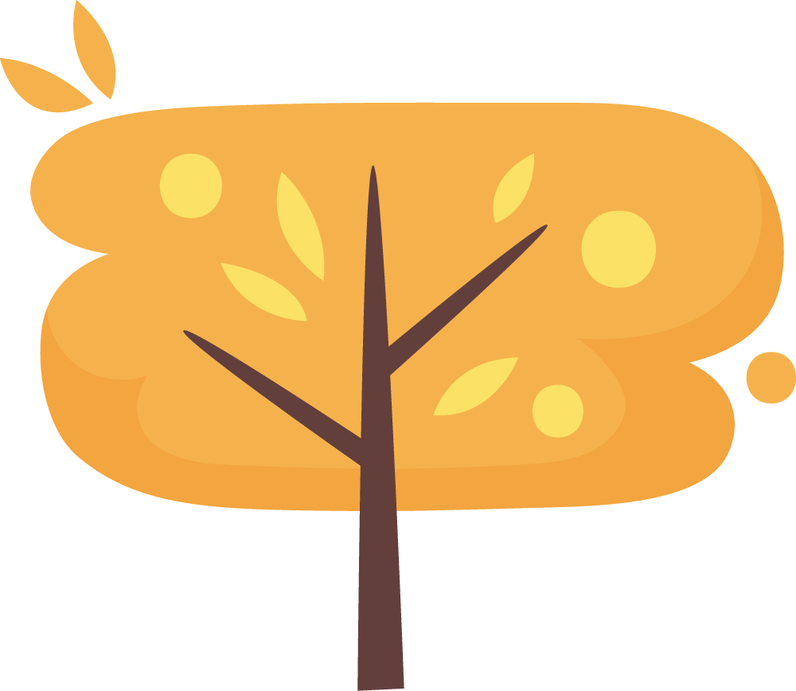
What is empathy?
Empathy means being able understand how someone else is feeling.
We may feel happy, sad, upset with someone else
You can “put yourself in someone else’s shoes” or see someone else’s side
Notes:
What is Empathy?
Empathy is when you can understand how someone else is feeling even if you aren’t in the same situation with them. Empathy skills help you predict what others may be feeling based on facial expressions, body language, or what you know about how other people might feel in the same situation.
Empathy is also about seeing someone else’s perspective, or their side of the story. Sometimes we call this “Putting yourself in someone else’s shoes.”
Empathy can be when you feel excited with someone because something good is happening in their life. You can feel sad with someone when something difficult happens. Maybe you feel nervous with them about an upcoming game or performance. These are all ways you feel something along with someone feels, even though the event isn’t happening to you personally.

Slide 3
Why is empathy important?
You just don’t understand!
It helps us have healthy relationships
Empathy helps us know how our actions impact others
It helps us understand different views and experiences
That was mean.

Slide 4
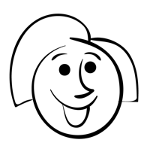
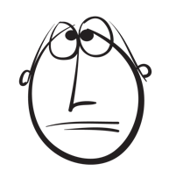
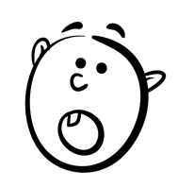
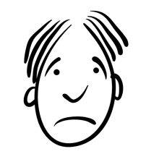
How do you build empathy?
Look for cues that help you identify emotions.
Happy
Sad
Confused
Excited
Worried
Hurt
Tired
Surprised
Angry
Joyful
Frustrated
Bored

Slide 5
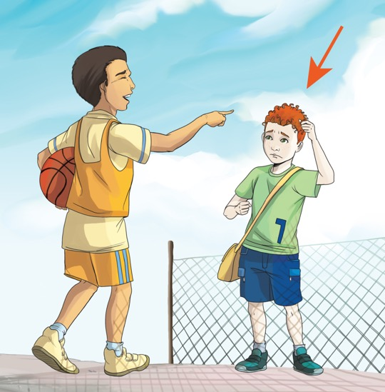
How might he be feeling?
hurt
sad
confused

Slide 6
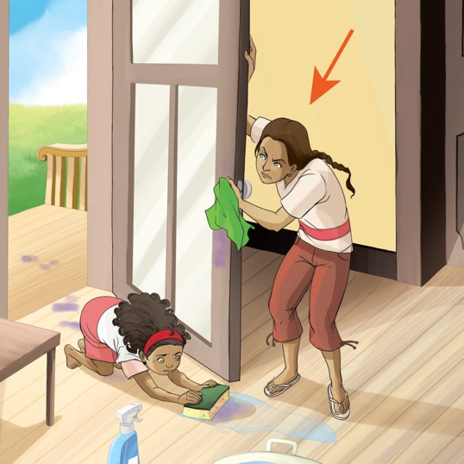
How might she be feeling?
angry
annoyed
frustrated

Slide 7
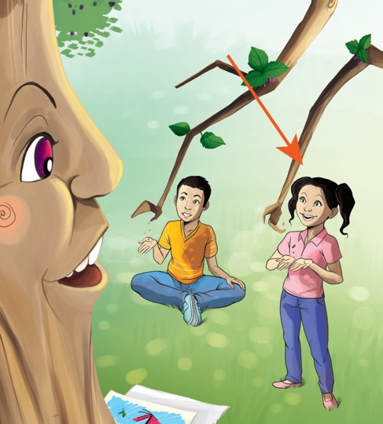
How might she be feeling?
joyful
curious
interested

Slide 8
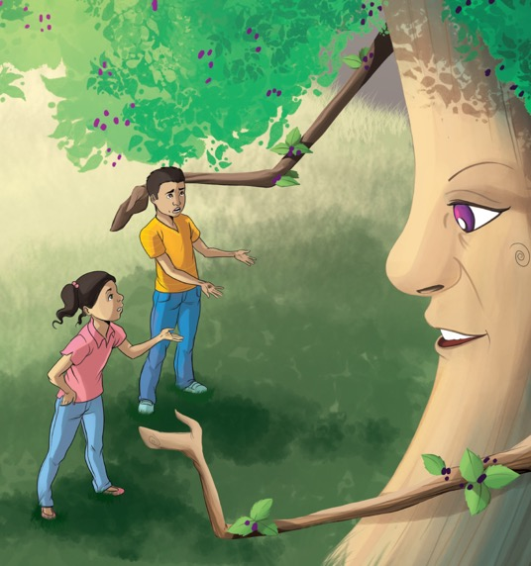
How might they be feeling?
worried
urgent
upset

Slide 9
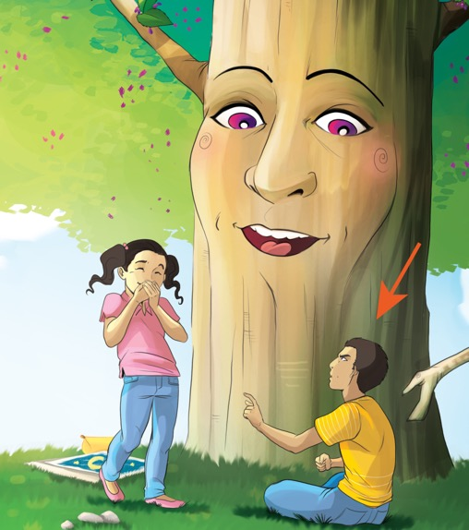
How might he be feeling?
It’s not fair
embarrassed
angry

Slide 10
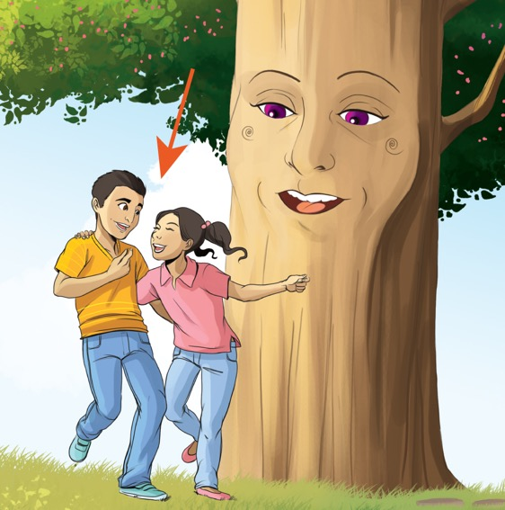
How might they be feeling?
excited
happy
silly

Slide 11
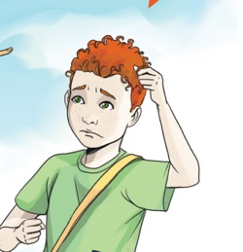
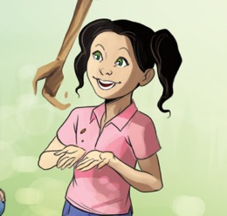
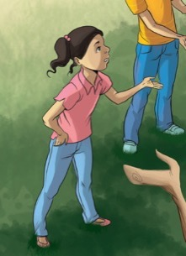
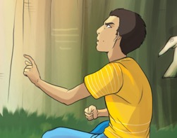
What is empathy?
Empathy means being able to understand how someone else is feeling.
Look for cues in faces and bodies that tell you how someone is feeling.

